Slide 1


Sentiment Analysis of Glasdoor Reviews
Madhukar Ayachit
DSC 680

Slide 2
Executive Summary
Glassdoor is a TripAdvisor for candidates in their job search. Glassdoor offers candidates a chance to look for jobs and read authentic and transparent reviews from employees currently and formerly employed in an organization.
Every organization has their pros and cons which their employees feel that it should be made public so that other people who wants to join this organization make decisions based on reviews from the people.
Glassdoor’s outreach is not limited to potential job seeker, it provides platform for existing employee to express his opinion about his current employer, HR & Employer can monitor their performance by analyzing behavioral patterns recorded in reviews. Similarly, recruiters and Branding team can pay attention to reviews for their strategies.
This project is an attempt to perform classification of existing reviews and provide a ML model for future prediction.
Madhukar Ayachit
DSC 680

Slide 3
Business Problem
Sentiment score is an important factor all the stake holders: employee, Employer, HR , Recruiter and Branding Team.
This project is an attempt to perform mining on Glassdoor reviews to have a better understanding of what the employee/ex-employee feels about the company. Project sets basic foundation for all the stake holders: employee, Employer, HR , Recruiter and Branding Team to take action to improve performance based on sentiment score.
This project presents sentiment analysis of Glasdoor reviews to help to come up with better behavioral strategy.
Madhukar Ayachit
DSC 680

Slide 4
Process Used
Data Collection
Data Wrangling
EDA & Visualizations
Modeling
Madhukar Ayachit
DSC 680

Slide 5
About Dataset
I have used following Kaggle link :
https://www.kaggle.com/datasets/ashwini1619/tcsglassdoorreviews
This is a sample dataset which mimics TCS employee reviews. Sample data set contains approximately 46 K reviews with 16 fields :
employID
Rating
reviewDate
reviewHeadLine
authorLocation
autherJobTitle
Pros
Cons
authorReviewLink
reviewDateIST
dayOfWeek
Month
dayOfMonth
Year
Peher
subRatings
Madhukar Ayachit
DSC 680

Slide 6
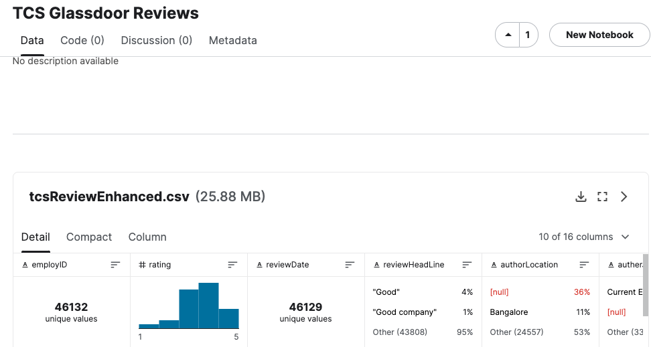
Data Exploration
Madhukar Ayachit
DSC 680

Slide 7
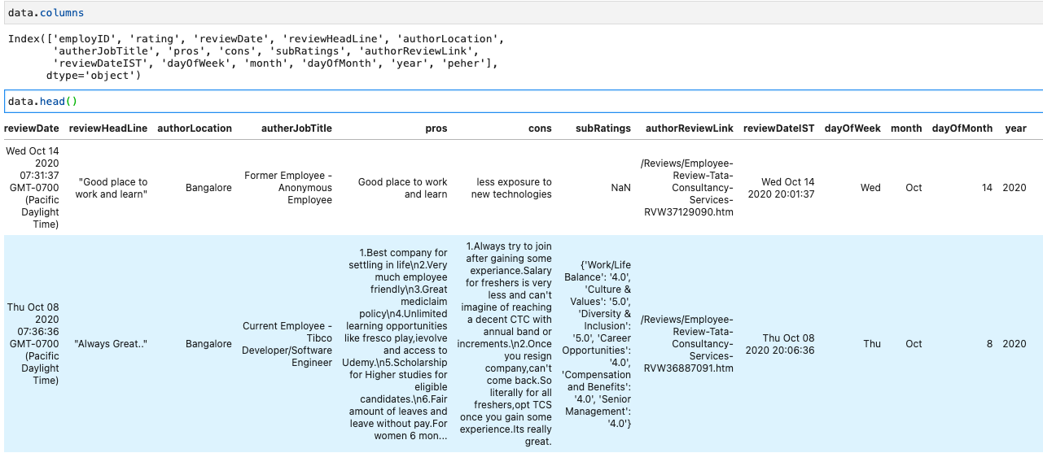
Data Exploration
Madhukar Ayachit
DSC 680

Slide 8
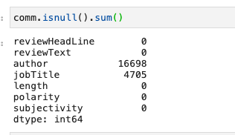
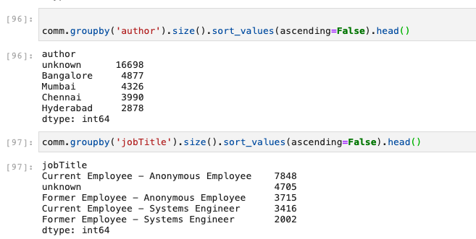
Data Exploration
Madhukar Ayachit
DSC 680

Slide 9
Data Preparation
Existing dataset provides two Important review fields : “Pros” & “Cons” along with “Rating” . There are additional fields like “JobTitle” and “AithorLocation” with date and time.
But my primary focus was review fields (Pros & Cons ). I clubbed both the fields into one “reviewText” field and completely ignored “Rating” field to derive my own “Sentiment Score” using TextBlog.
However, review text is being processed using 3 step process to take care of cleanup of : special characters like “?” , space , punctuation etc.
Second step is to remove stop words like : "a", "an", "the", "this", "that", "is", "it", "to", "and”
In final step Stemming & Lemmatization being done on the review text
Madhukar Ayachit
DSC 680

Slide 10
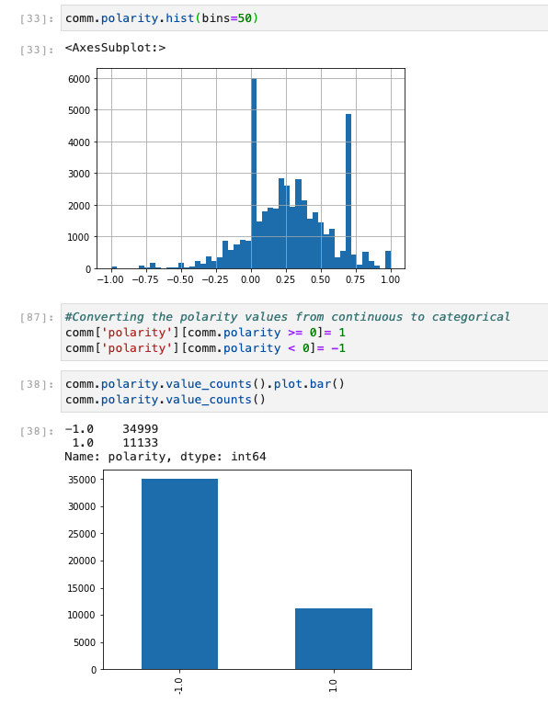
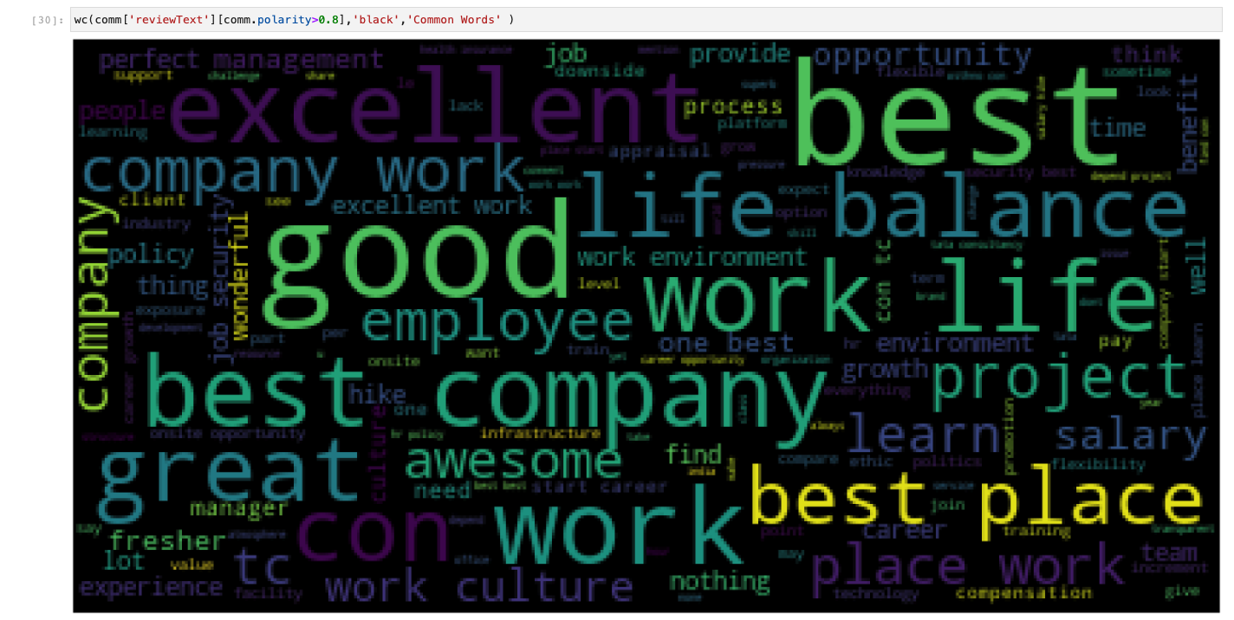
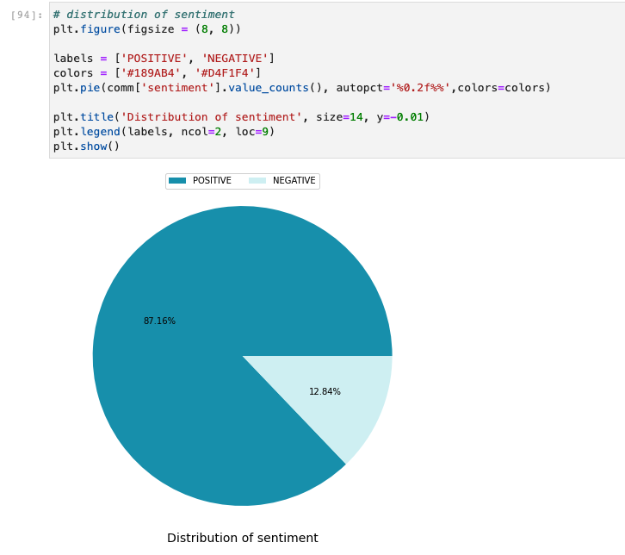
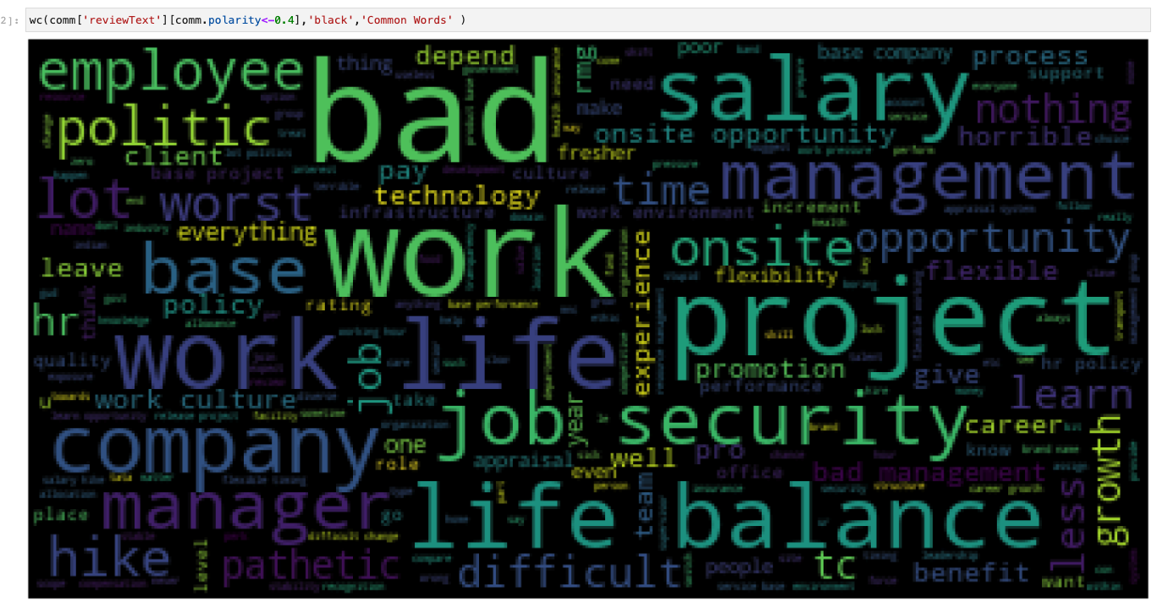
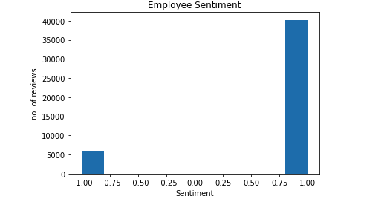
Visualization
Madhukar Ayachit
DSC 680

Slide 11
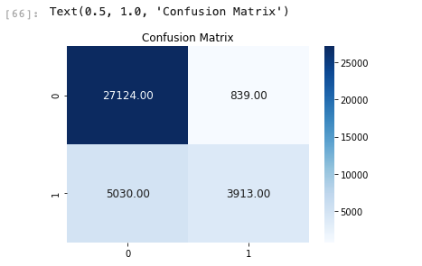
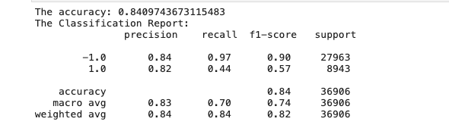
Modeling & Evaluation
Considering binary outcome I have decided to go for logistic regression. Overall result shows 84% accuracy
Madhukar Ayachit
DSC 680

Slide 12
Summary
I am able to successfully run and test model with 84% accuracy. I have considered other models like like CART and SVM but Logistic Regression came with better score and accuracy.
Madhukar Ayachit
DSC 680

